Slide 1
软件建模：基于CPU的多边形渲染
18721802 李琦
18721825 吴杰 2018.12.17

Slide 2



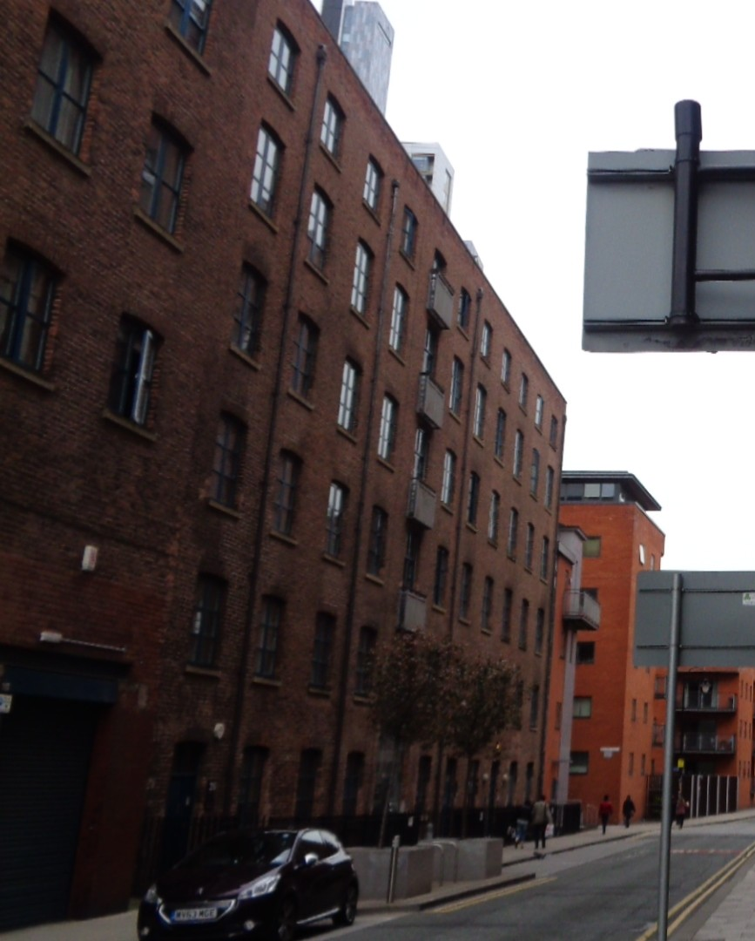



CONTENTS
建模工具调研
渲染系统需求分析
UML基本模型
分工

Slide 3
建模工具调研
Rational Rose
PowerDesigner
RGui
一种面向对象的统一建模语言的可视化建模工具。用于可视化建模和公司级水平软件应用的组件构造。
对系统的代码框架生成有很好的支持。但对数据库的开发管理和数据库端的迭代不是很好。
PowerDesigner原来是对数据库建模而发展起来的一种数据库建模工具。
对UML的建模使用到的各种图的支持比较滞后。但是在最近得到加强。所以使用它来进行UML开发的并不多，很多人都是用它来作为数据库的建模。
R软件是一款专业的统计建模软件，与其它建模软件不同的是这款软件完全免费、开源，所以深受大家的青睐。R软件拥有数据存储和处理系统；数组运算工具（其向量、矩阵运算方面功能尤其强大）；完整连贯的统计分析工具；优秀的统计制图等多种功能。

Slide 4
渲染系统需求分析
系统功能需求
数据处理模块
系统绘制模块

Slide 5

Analysis
Description
系统的功能主要包括以下几个方面：
1.用户选择渲染模式（线框/填充
2.用户选择空间观察位置/视角
3.用户选择创建图形类型及位置
4.用户选择贴图

Slide 6

Analysis
数据处理模块
数据处理模块包括以下几个方面：
1.对顶点坐标的矩阵变换支持
2.对顶点，颜色的插值
3.对用户位置坐标进行矩阵变换
4.对贴图的映射插值

Slide 7

Analysis
系统绘制模块
系统绘制模块包括以下几个方面：
1.对指定像素点的绘制
2.对线段绘制
3.对三角形绘制
4.光栅化扫描线填充

Slide 8
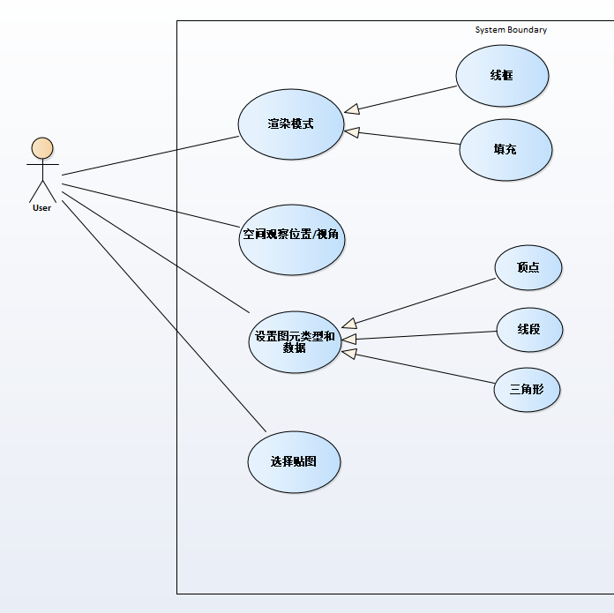
系统用例图

Slide 9


Annual Training Plan
Internal Training
External Training
Ongoing Coaching

Slide 10

Internal Training
Training Needs
Administration
Evaluation
Make a training need survey around all departments and analyze their needs.
Schedule all training classes according to the need analysis with instructors and students.
Finish all three out of four levels of evaluation and record the training result. Action plan will be necessary.

Slide 11
External Training
Trainees/
Requestors
Supervisor/
Manager
Training Dept.
Finance Dept.
General Manager
Training Request
Training Analysis
Training Permission
Monitor & Permission
Permission
Payment Request
Attendance
Training Fee Payment
Prepare hotel & meal invoices, training report and certificate
Announcement
Pay Bills
Reimbursement
Money Back

Slide 12
Ongoing Coaching
Ongoing Coaching
Strategic Awareness
Customer-orientation
Individual Development
Mission
Vision
Division
Centralization
Service
Cooperation
Qualification
Promotion
Ongoing Coaching is introduced to track the improvement after training.

Slide 13
Project Management
Learning System
Talent Management
Performance

Slide 14






Learning System
Learning System
Course System
Training Paper Files
A system which will cover all database and delete all paper work.
Instructor Database
Evaluation Database

Slide 15
Learning System
Managers
Supervisor A
Supervisor B
Supervisor C
…
Member a1
Member a2
…
Member b1
Member b2
…
…
…
Training Administrator
Control and response to all training requirements in the department.
Follow up all training projects and track the completion.
Analyze all team members regularly and propose the training or coaching plan.
Attend all compulsory training courses and select optional courses according to the quarterly performance.

Slide 16
Talent Management
Career Development
People on the same ladder are encouraged to rotate* to extend their skills.
Manager
Supervisor
Team Leader
Team Member
Intern
Recruitment
Rotation
Promotion
It’s the best method to introduce people of new ideas.
Opportunities will be firstly offered in internal recruitment.
*Rotation will not just happen in the same boundaries, but this is a two-way choice.

Slide 17
Performance
The target of 2015 is 2.7 billion each quarter. It’s very clear that only Q2 completed the task.
Q3 and Q4 are expected data according to the pre-order.
This trend is affected by the weak USD.
Year-end bonus will be aligned with yearly sales.

Slide 18
Management Effectiveness
Leadership
Internship
Communication

Slide 19
Leadership
VCS Visual Control Standard
CPC Central Process Control
BEF Beave Elite Forum
High potential talents will be covered in all three programs. Undergraduate interns are the most preferred people.

Slide 20
Internship
21 interns are hired into 5 different departments: HR, Sales, Logistics, Finance, Engineering, Design and Development.

Slide 21
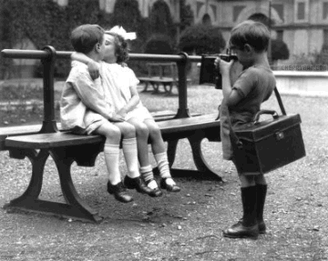





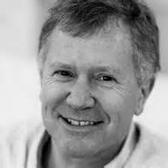
Communication
This is a place where you work with love.

Slide 22


Thank you
If you need further assistance, please contact:
@PPTonna
PPTonna
tonnatang@live.com

Slide 23

更多精品PPT资源尽在—PPT宝藏！
www.PPTBZ.com
Notes:
模板来自于 http://www.ypppt.com

